Slide 1

Database Processing: Fundamentals, Design, and Implementation
15th Edition
Chapter 2
Part 2
Introduction to Structured Query Language

Slide 2
Learning Objectives (1 of 2)
2.1 To understand the use of extracted datasets in business intelligence (BI) systems
2.2 To understand the use of ad-hoc queries in business intelligence (BI) systems
2.3 To understand the history and significance of Structured Query Language (SQL)
2.4 To understand the SQL SELECT/FROM/WHERE framework as the basis for database queries
2.5 To create SQL queries to retrieve data from a single table
2.6 To create SQL queries that use the SQL SELECT, FROM, WHERE, ORDER BY, GROUP BY, and HAVING clauses
2.7 To create SQL queries that use the SQL DISTINCT, TOP, and TOP PERCENT keywords
2.8 To create SQL queries that use the SQL comparison operators, including BETWEEN, LIKE, IN, and IS NULL

Slide 3
Learning Objectives (2 of 2)
2.9 To create SQL queries that use the SQL logical operators, including AND, OR, and NOT
2.10 To create SQL queries that use the SQL built-in aggregate functions of SUM, COUNT, MIN, MAX, and AVG with and without the SQL GROUP BY clause
2.11 To create SQL queries that retrieve data from a single table while restricting the data based upon data in another table (subquery)
2.12 To create SQL queries that retrieve data from multiple tables using the SQL join and JOIN ON operations
2.13 To create SQL queries on recursive relationships
2.14 To create SQL queries that retrieve data from multiple tables using the SQL OUTER JOIN operation
2.15 To create SQL queries that retrieve data from multiple tables using SQL set operators UNION, INTERSECT, and EXCEPT

Slide 4
Chapter 2 Part 2 Coverage
This Microsoft PowerPoint Slide Show covers multiple table queries and chapter objectives 2.11-2.15.
The material in the Microsoft PowerPoint Slide Show for Chapter Two Part One on single table queries must by covered before discussing the material in this Slide Show.
A review of the Cape Codd Outdoor Sports database is included for continuity.

Slide 5
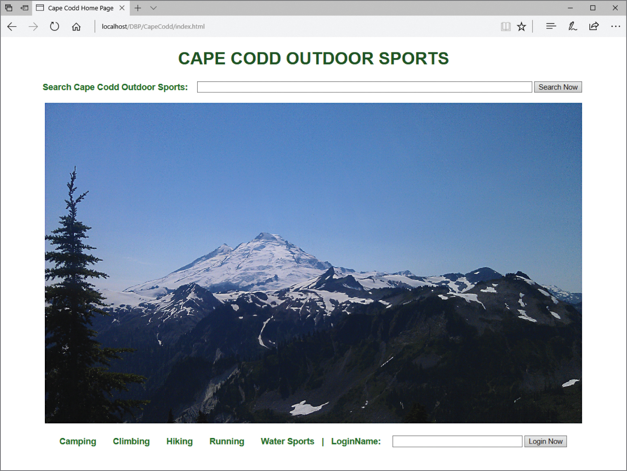
Figure 2-1 Cape Codd Outdoor Sports

Slide 6
Cape Codd Outdoor Sports Background
Cape Codd Outdoor Sports is a fictitious company based on an actual outdoor retail equipment vendor.
Cape Codd Outdoor Sports:
Has 15 retail stores in the United States and Canada
Has an online Internet store
Has a (postal) mail order department
All retail sales are recorded in an Oracle Database 12c Release 2 DBMS.

Slide 7
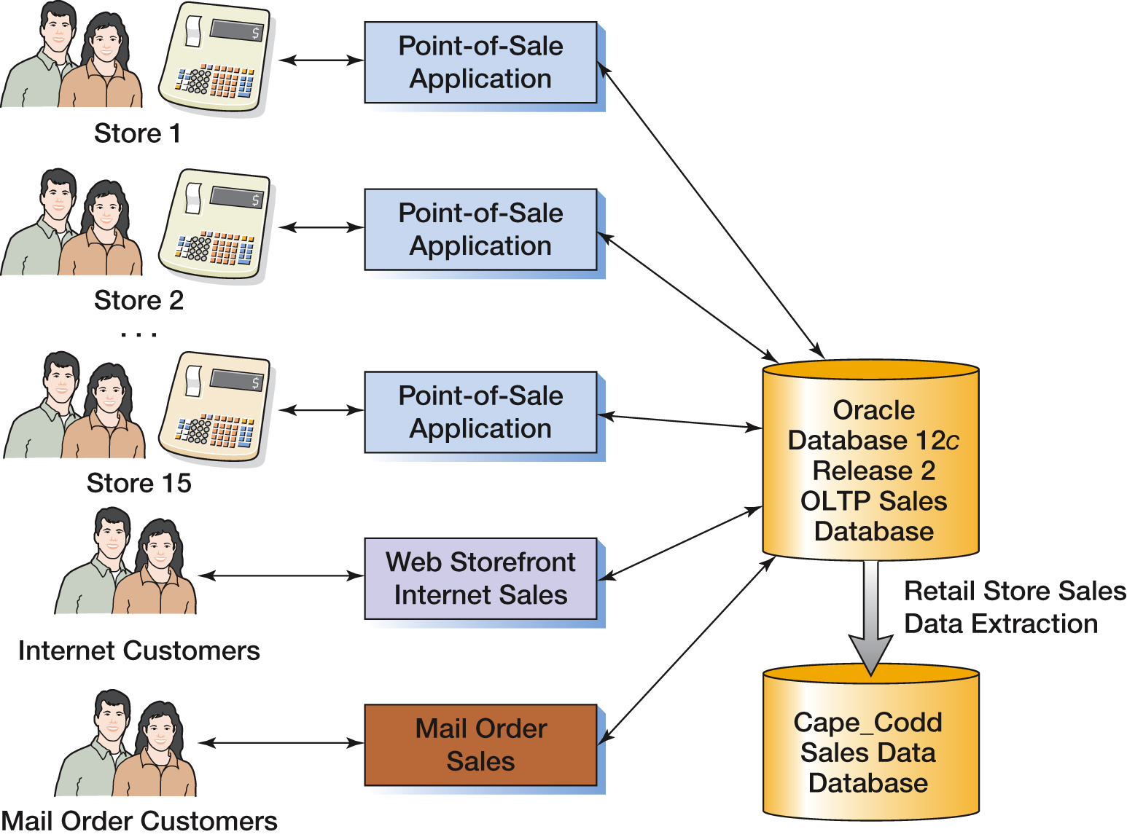
Figure 2-2 Cape Codd Retail Sales Data Extraction Process

Slide 8
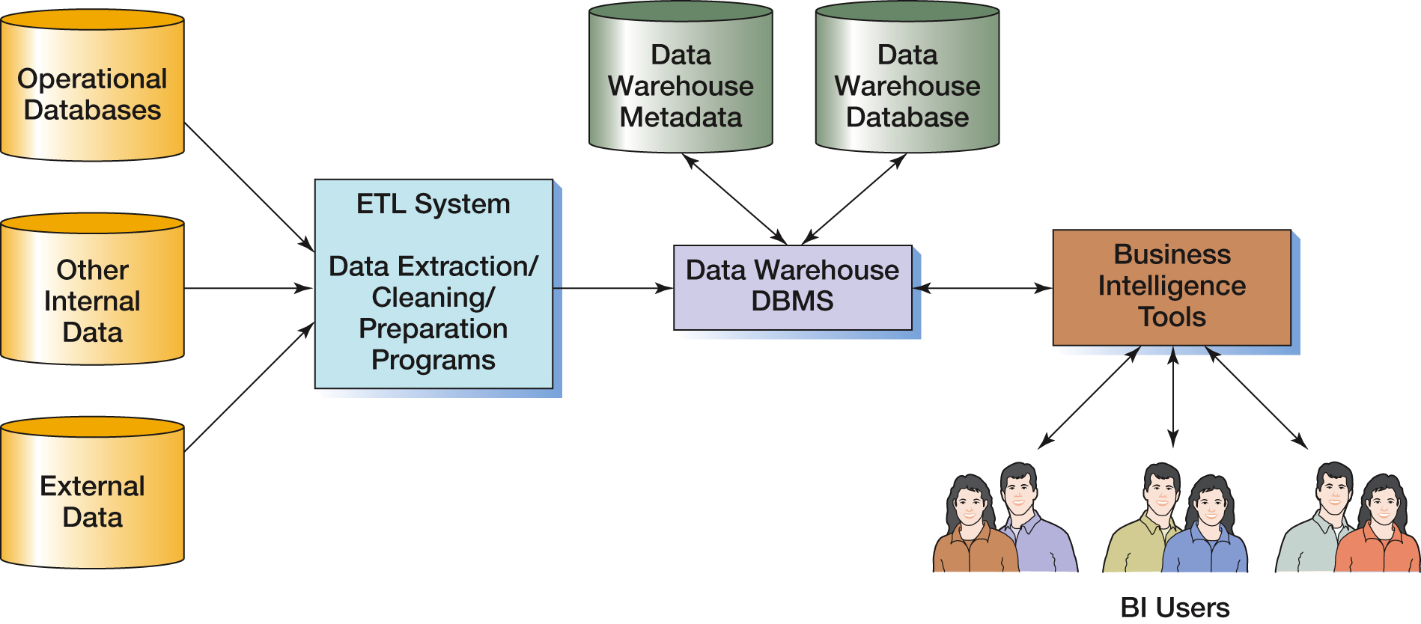
Figure 2-3 Components of a Data Warehouse

Slide 9
Cape Codd Outdoor Sports Retail Sales and Catalog Context Data Extraction 1
The Cape Codd marketing department needs an analysis of:
In-store sales
Catalog content
The entire database is not needed for this, only an extraction of retail sales data and catalog content.
The data is extracted by the IS department from the operational database into a separate, off-line database for use by the marketing department.

Slide 10
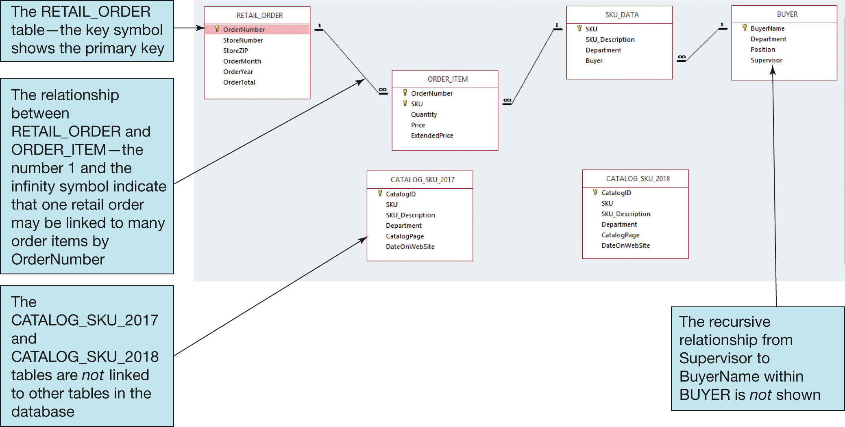
Figure 2-4 Extracted Retail Sales Data Database Tables

Slide 11
Figure 2-5 (1 of 2) Cape Codd Extracted Retail Sales Data Format (1 of 2)
Table
RETAIL_ORDER
ORDER_ITEM
Column | Data Type
OrderNumber | Integer
StoreNumber | Integer
StoreZIP | Character (9)
OrderMonth | Character (12)
OrderYear | Integer
OrderTotal | Currency
OrderNumber | Integer
SKU | Integer
Quantity | Integer
Price | Currency
ExtendedPrice | Currency

Slide 12
Figure 2-5 (2 of 2) Cape Codd Extracted Retail Sales Data Format (2 of 2)
Table
SKU_DATA
BUYER
CATALOG_SKU_20##
Column | Data Type
SKU | Integer
SKU_Description | Character (35)
Department | Character (30)
Buyer | Character (35)
BuyerName | Character (35)
Department | Character (30)
Position | Character (10)
Supervisor | Character (35)
CatalogID | Integer
SKU | Integer
SKU_Description | Character (35)
Department | Character (30)
CatalogPage | Integer
DateOnWebSite | Date

Slide 13
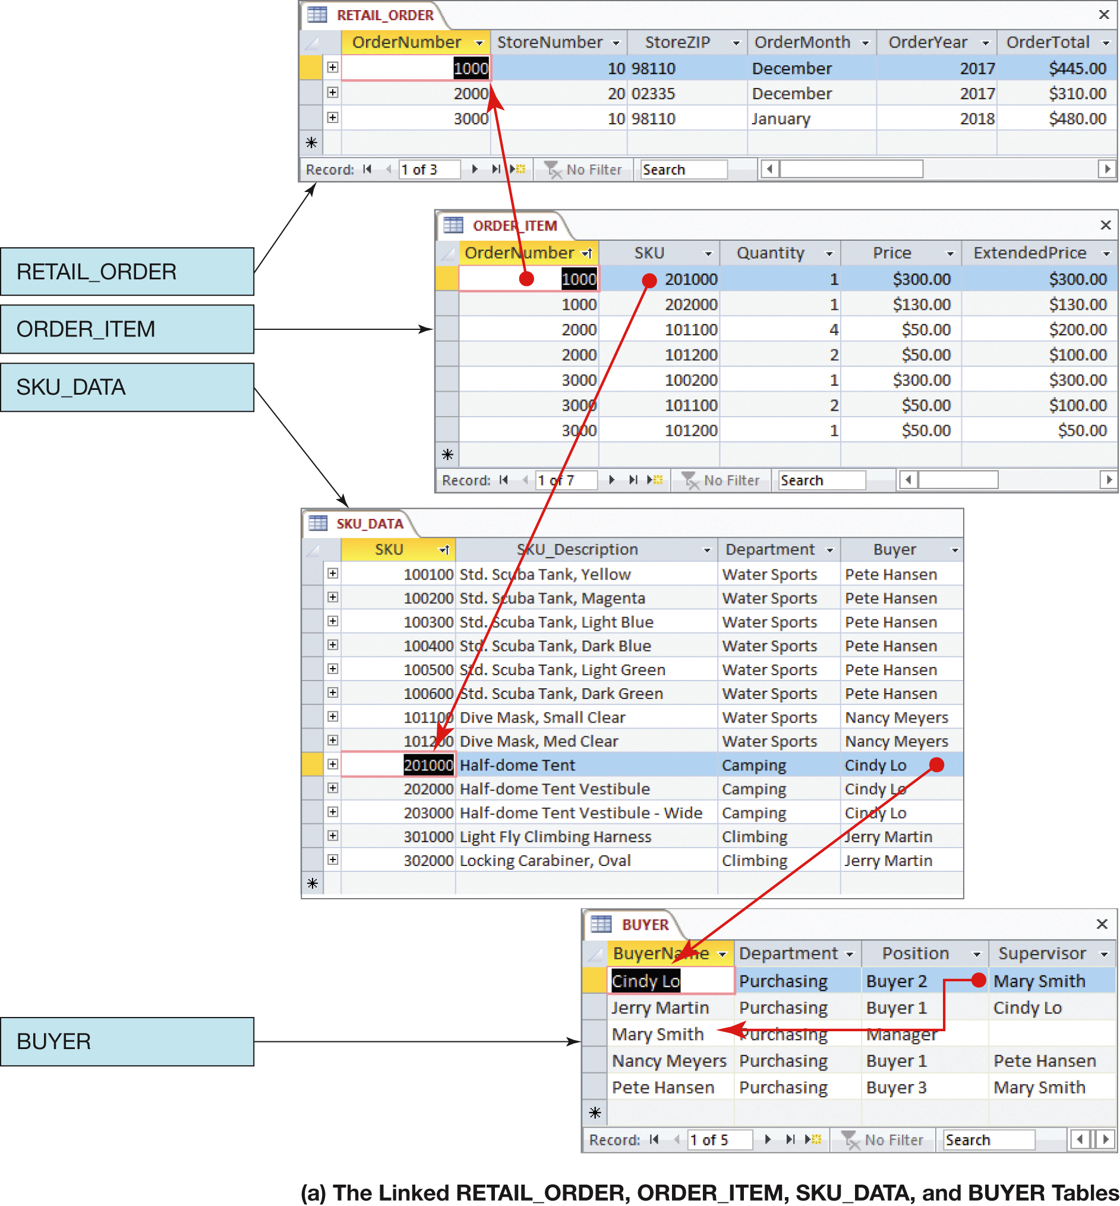
Figure 2-6 (1 of 2) Extracted Retail Sales Database (1 of 2)

Slide 14
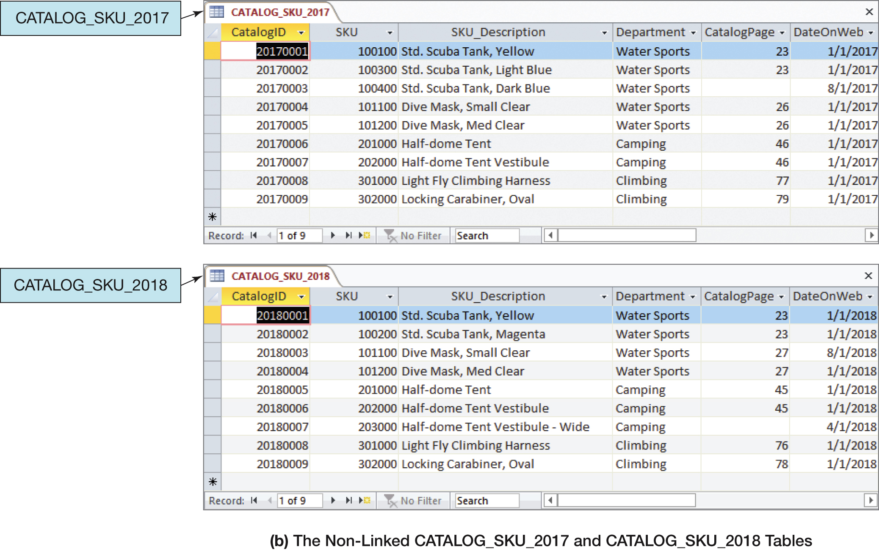
Figure 2-6 (2 of 2) Extracted Retail Sales Database (2 of 2)

Slide 15
Cape Codd Database Available Online (1 of 2)
Versions of the complete Cape Codd database are available in the downloadable Student Files available at:
http://www.pearsonhighered.com/kroenke/
These include versions for:
Microsoft Access 2016
Microsoft SQL Server 2017
Oracle Database XE
MySQL 5.7
We recommend you actually run all material in a live database!

Slide 16
Cape Codd Database Available Online (2 of 2)
To complete setting up the Cape Codd database, set the referenced materials:
For Microsoft SQL Server 2014:
See Online Chapter 10A
For Oracle Database 12c and Oracle Database XE:
See Online Chapter 10B
For MySQL 5.6
See Online Chapter 10C
Online chapters 10A, 10B, and 10C are available for download at:
http://www.pearsonhighered.com/kroenke/

Slide 17
Querying Two or More Tables with SQL
SQL provides two different techniques for querying data from multiple tables:
The SQL subquery
The SQL join
Although both work with multiple tables, they are used for slightly different purposes.

Slide 18
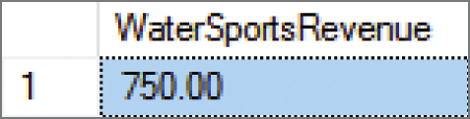
Querying Multiple Tables with SQL Subqueries (1 of 5) The Logic of Subqueries I
We want to know the revenue for Water Sports items, which have SKU values of 100100, 100200, 101100, and 101200.
Given that we know the SKU values, we can use this query:
/* *** SQL-Query-CH02-53 *** */
SELECT SUM(ExtendedPrice) AS WaterSportsRevenue
FROM ORDER_ITEM
WHERE SKU IN (100100, 100200, 100300, 100400, 100500, 100600, 101100, 101200);

Slide 19
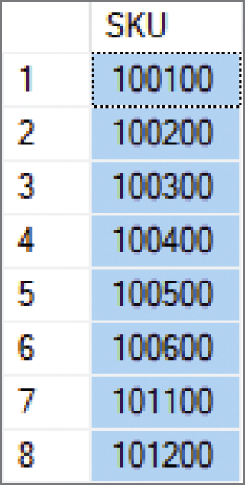
Querying Multiple Tables with SQL Subqueries (2 of 5) The Logic of Subqueries II
What if we don’t know the SKU values? We can determine them with this query:
/* *** SQL-Query-CH02-54 *** */
SELECT SKU
FROM SKU_DATA
WHERE Department = 'Water Sports';

Slide 20

Querying Multiple Tables with SQL Subqueries (3 of 5) The Logic of Subqueries III
We can combine these two as shown in SQL-Query-02-55. The second query, which is enclosed in parentheses, is called an SQL subquery. Note how the subquery returns a set of values for use by the top level query, and note the use of the SQL IN keyword.
/* *** SQL-Query-CH02-55 *** */
SELECT SUM(ExtendedPrice) AS WaterSportsRevenue
FROM ORDER_ITEM
WHERE SKU IN
(SELECT SKU
FROM SKU_DATA
WHERE Department = 'Water Sports');

Slide 21
Querying Multiple Tables with SQL Subqueries (4 of 5) The Logic of Subqueries IV
An SQL subquery is often described as:
A nested query
A query within a query
Note that SQL queries using subqueries are still effectively single table queries in the sense that only the columns of the top level query can be displayed in the query results!
Multiple subqueries can be used to process three or even more tables.
All parts if the SQL SELECT statement syntax can be applied to the table displaying the results of an SQL query using subqueries.

Slide 22
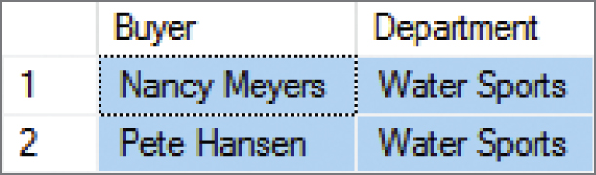
Querying Multiple Tables with SQL Subqueries (5 of 5) The Logic of Subqueries V
/* *** SQL-Query-CH02-56 *** */
SELECT DISTINCT Buyer, Department
FROM SKU_DATA
WHERE SKU IN
(SELECT SKU
FROM ORDER_ITEM
WHERE OrderNumber IN
(SELECT OrderNumber
FROM RETAIL_ORDER
WHERE OrderMonth = 'January’
AND OrderYear = 2018));

Slide 23
Querying Multiple Tables with SQL Joins (1 of 10) The Logic of Joins
In an SQL join operation, the SQL JOIN operator is used to combine parts or all of two or more tables.
Explicit join ─ the SQL JOIN operator is used as part of the SQL statement.
Implicit join ─ the SQL JOIN operator is not used as part of the SQL statement.

Slide 24
Querying Multiple Tables with SQL Joins (2 of 10) SQL CROSS JOIN
An SQL CROSS JOIN combines each row in one table with every row in another table.
/* *** SQL-Query-CH02-58 *** */
SELECT *
FROM RETAIL_ORDER, ORDER_ITEM;
This is known mathematically as a Cartesian product of the rows in the tables.
This is illogical in database work because we only need rows that somehow logically correspond in the two tables.

Slide 25
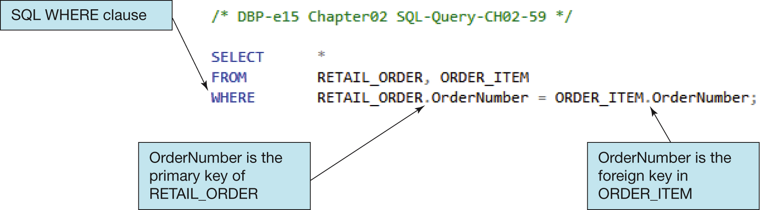
Querying Multiple Tables with SQL Joins (3 of 10) Implicit SQL INNER JOIN I
By selecting rows by matching by the primary key values of one table with the foreign key values of a second table, we produce an SQL INNER JOIN.
Because the SQL JOIN keyword does not appear in the SQL statement, this is an implicit join.

Slide 26
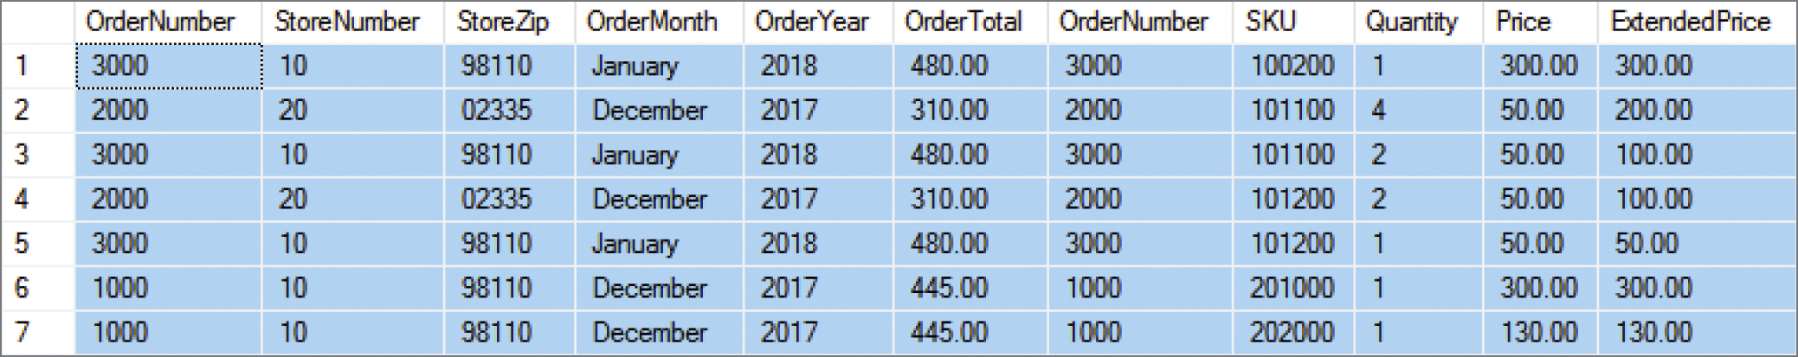
Querying Multiple Tables with SQL Joins (4 of 10) Implicit SQL INNER JOIN II
/* *** SQL-Query-CH02-59 *** */
SELECT *
FROM RETAIL_ORDER, ORDER_ITEM
WHERE RETAIL_ORDER.OrderNumber = ORDER_ITEM.OrderNumber;

Slide 27
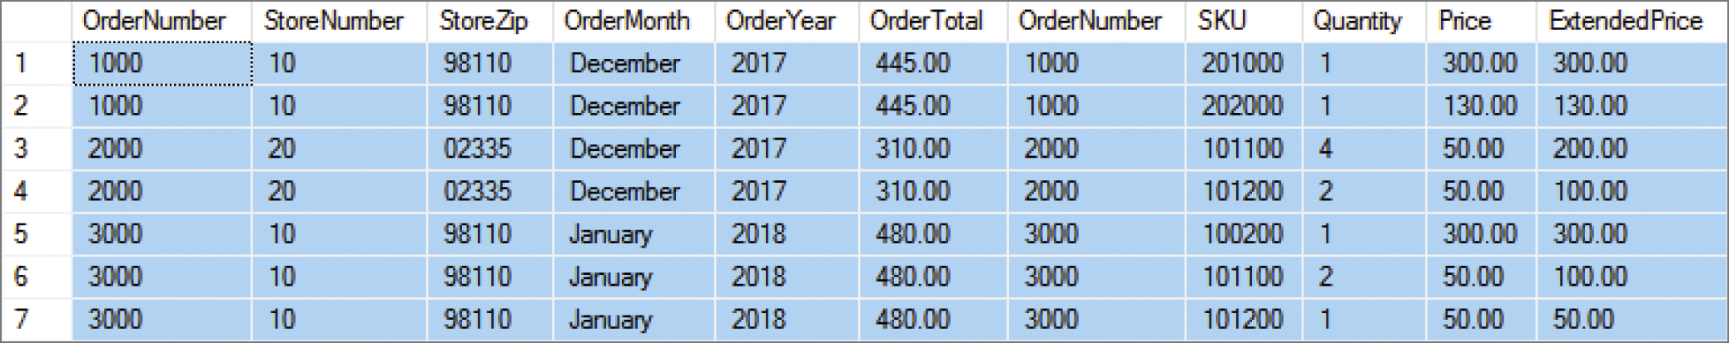
Querying Multiple Tables with SQL Joins (5 of 10) Implicit SQL INNER JOIN III
With an SQL ORDER BY clause for easier reading by OrderNumber:
/* *** SQL-Query-CH02-60 *** */
SELECT *
FROM RETAIL_ORDER, ORDER_ITEM
WHERE RETAIL_ORDER.OrderNumber = ORDER_ITEM.OrderNumber ORDER BY RETAIL_ORDER.OrderNumber, ORDER_ITEM.SKU;

Slide 28
Querying Multiple Tables with SQL Joins (6 of 10) EQUIJOIN
The process of using an SQL JOIN operation to join two tables is called joining the two tables.
When tables are joined using an equal to condition as in the example above, the join is called an equijoin.
When people say “join,” 99.99999 percent of the time they mean equijoin.
Multiple joins can be used to process three or even more tables.
All parts of the SQL SELECT statement syntax can be applied to the table displaying the results of an SQL query using joins.

Slide 29
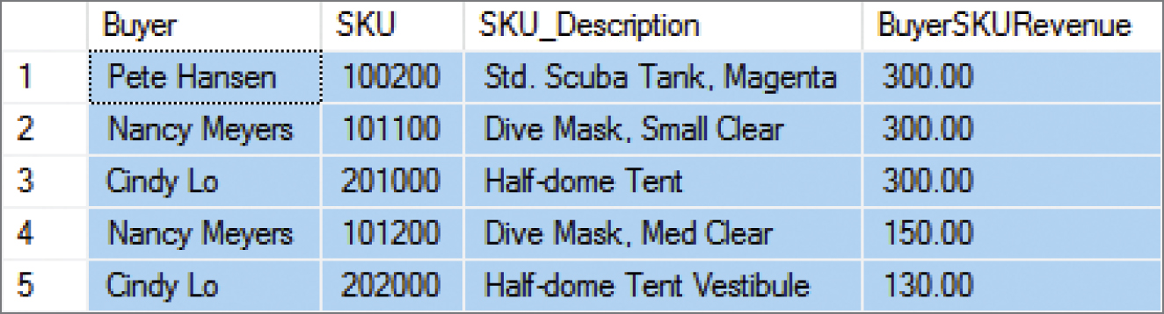
Querying Multiple Tables with SQL Joins (7 of 10) The Logic of Joins
/* *** SQL-Query-CH02-62 *** */
SELECT Buyer, SKU_DATA.SKU, SKU_Description,
SUM(ExtendedPrice) AS BuyerSKURevenue
FROM SKU_DATA, ORDER_ITEM
WHERE SKU_DATA.SKU = ORDER_ITEM.SKU
GROUP BY Buyer, SKU_DATA.SKU, SKU_Description
ORDER BY BuyerSKURevenue DESC;

Slide 30
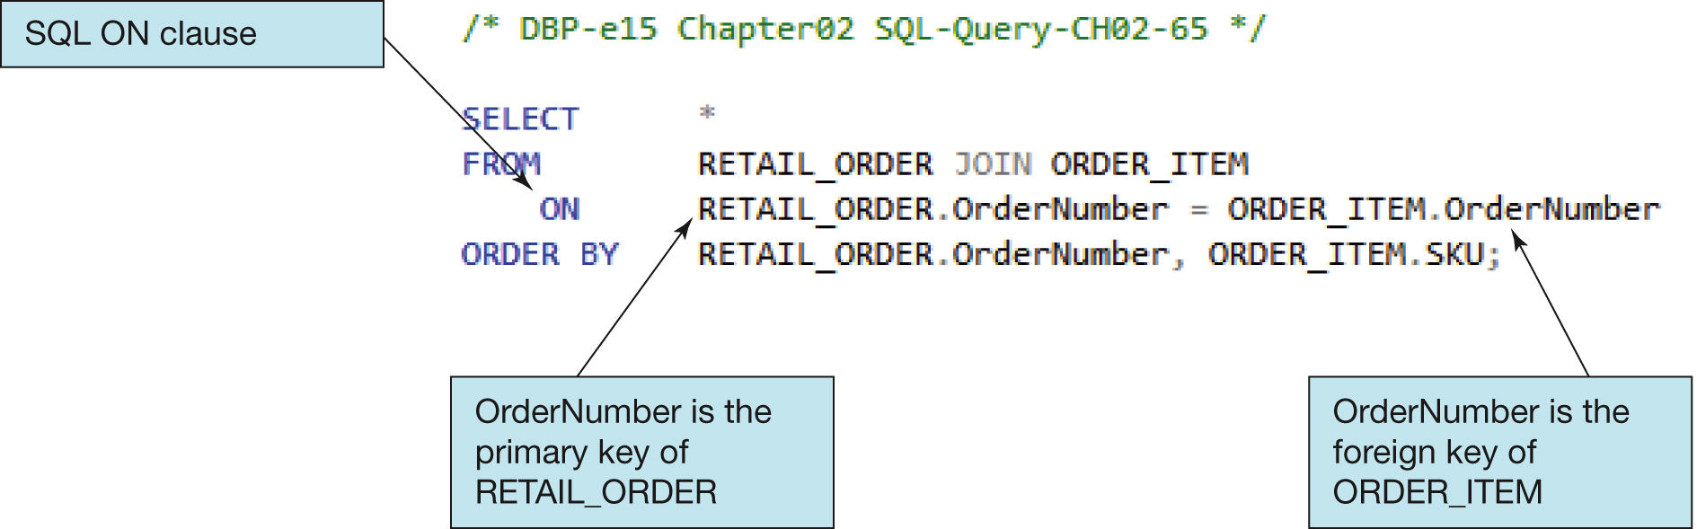
Querying Multiple Tables with SQL Joins (8 of 10) Explicit SQL INNER JOIN
Selecting rows by matching by the primary key values of one table with the foreign key values of a second table, we produce an SQL INNER JOIN.
Because the SQL JOIN keyword does appear in the SQL statement, this is an explicit join.

Slide 31
Querying Multiple Tables with SQL Joins (9 of 10) SQL JOIN ON Syntax
In SQL JOIN ON syntax:
The SQL JOIN keyword is placed between the table names in the SQL FROM clause, where it replaces the comma that previously separated the two table names.
The SQL ON keyword now leads into an SQL ON clause, which includes the statement of matching key values that was previously in an SQL WHERE clause.
The SQL WHERE clause is no longer used as part of the join, which makes it easier to read the actual restrictions on the rows in the query in the SQL WHERE clause itself.
The explicit SQL JOIN ON syntax is currently considered as the proper way to write SQL join operations, and the older implicit SQL syntax is considered an archaic, older syntax (but it still works).

Slide 32
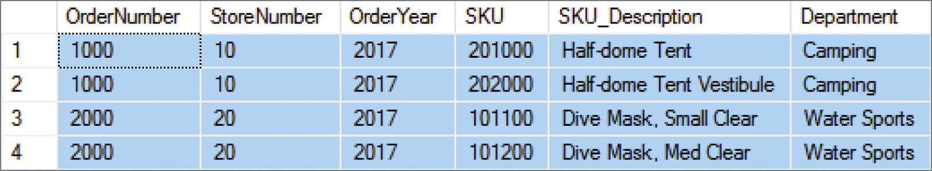
Querying Multiple Tables with SQL Joins (10 of 10) The Logic of Joins
/* *** SQL-Query-CH02-66 *** */
SELECT *
FROM RETAIL_ORDER JOIN ORDER_ITEM
ON RETAIL_ORDER.OrderNumber = ORDER_ITEM.OrderNumber WHERE OrderYear = 2017
ORDER BY RETAIL_ORDER.OrderNumber, ORDER_ITEM.SKU;

Slide 33
SQL Subqueries versus SQL Joins
SQL subqueries and SQL joins both process multiple tables.
An SQL subquery can only be used to retrieve data from the “top table.”
An SQL join can be used to obtain data from any number of tables, including the “top table” of the subquery.
In Chapter 8, we will study the correlated subquery. That kind of subquery can do work that is not possible with joins.

Slide 34
SQL Queries on Recursive Relationships (1 of 3)
Recursive means that something recurs or repeats.
A recursive procedure (in computer programming languages) is a block of code that calls itself.
A recursive relationship (in database structures) is a relationship between two columns in the same table.

Slide 35
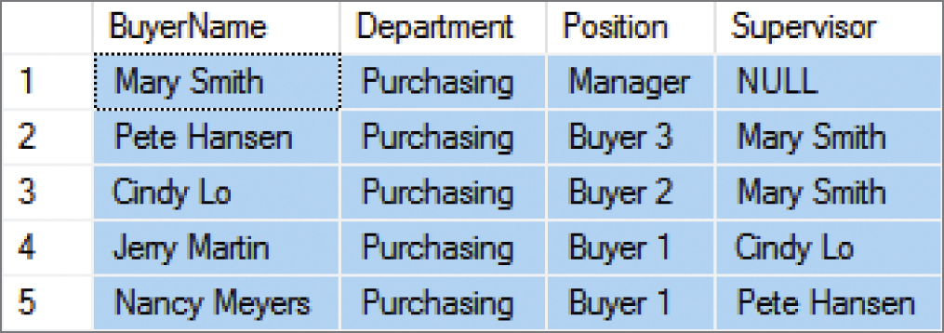
SQL Queries on Recursive Relationships (2 of 3)
In the Cape Codd Outdoor Sports data extract below, the BUYER table has a recursive relationship: the Supervisor column holds value of the BuyerName column as data and serves as a foreign key referencing BuyerName as the associated primary key.
/* *** SQL-Query-CH02-70 *** */
SELECT BuyerName, Department, Position, Supervisor
FROM BUYER
ORDER BY Position DESC;

Slide 36
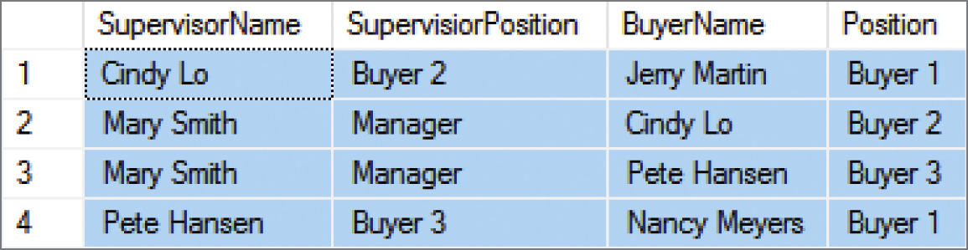
SQL Queries on Recursive Relationships (3 of 3)
The solution is to use table aliases to create two aliased versions of the same single table. Thus, the query below lists each BuyerName and that person’s Supervisor:
/* *** SQL-Query-CH02-71 *** */
SELECT S.BuyerName AS SupervisorName, S.Position AS SupervisorPosition, B.BuyerName, B.Position
FROM BUYER S JOIN BUYER B
ON S.BuyerName = B.Supervisor ORDER BY S.BuyerName;

Slide 37
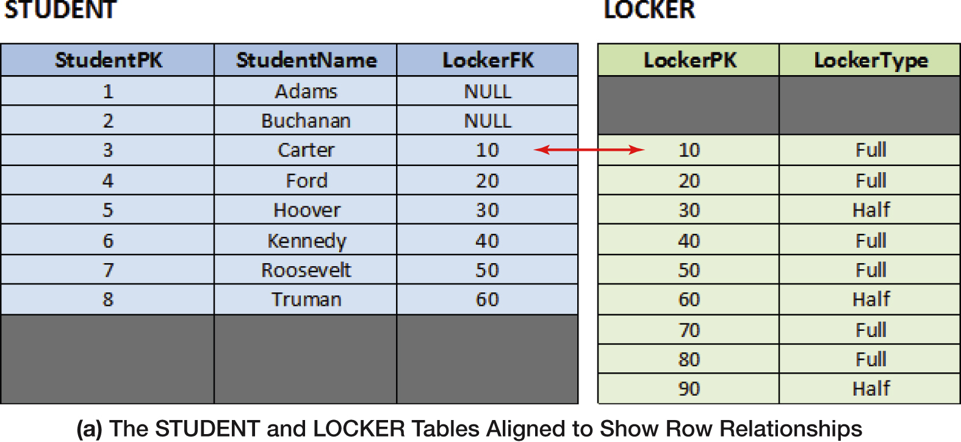
Figure 2-32 (1 of 4) The Logic of Outer Joins – Example Tables

Slide 38
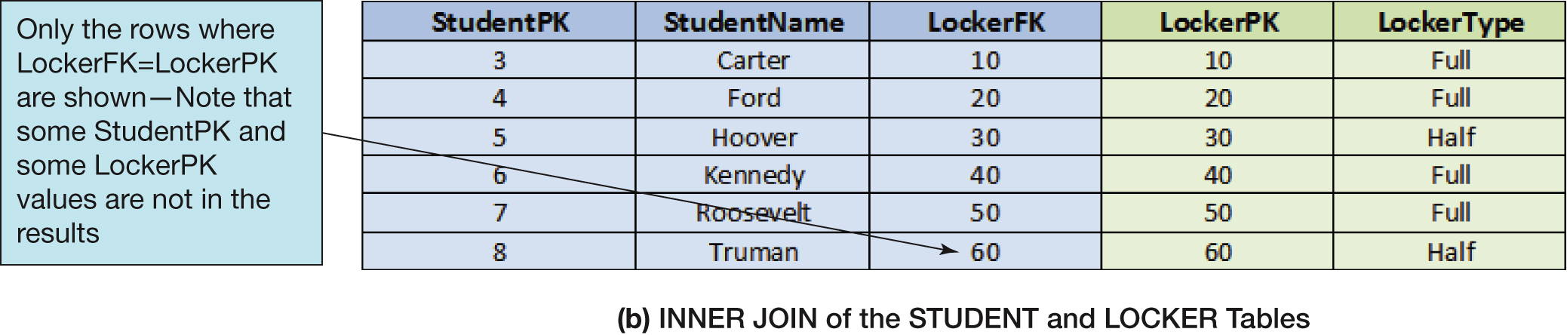
Figure 2-32 (2 of 4) INNER JOIN (STUDENT and LOCKER Tables)

Slide 39
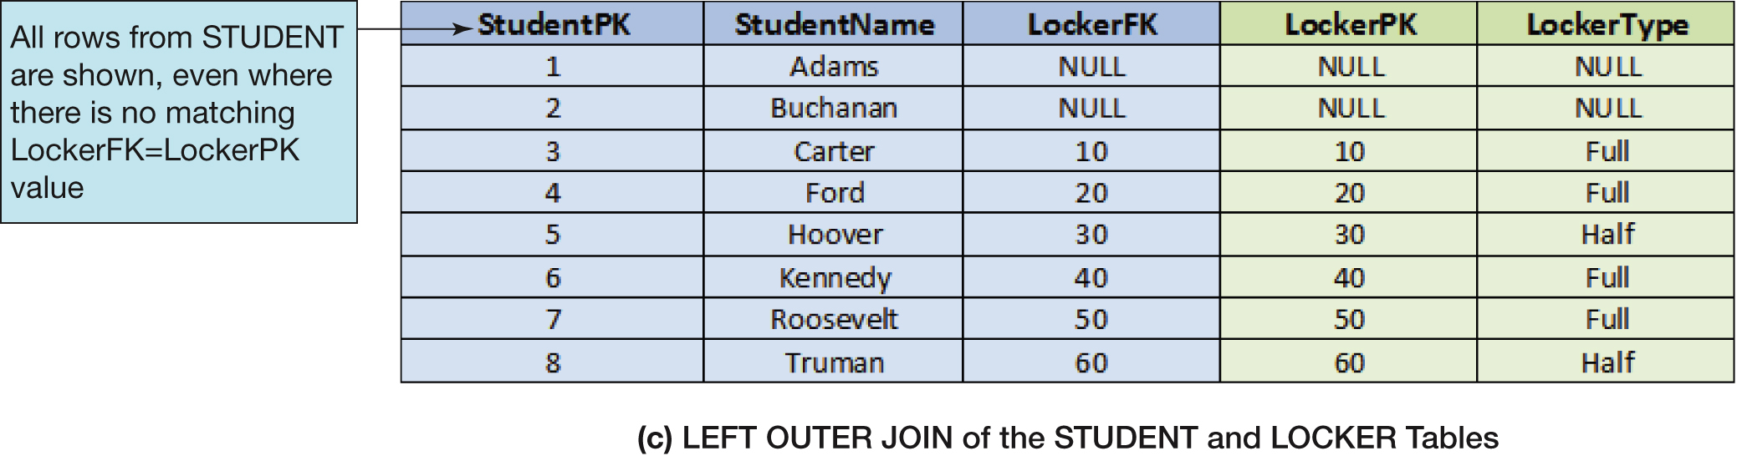
Figure 2-32 (3 of 4) LEFT OUTER JOIN (STUDENT and LOCKER Tables)

Slide 40
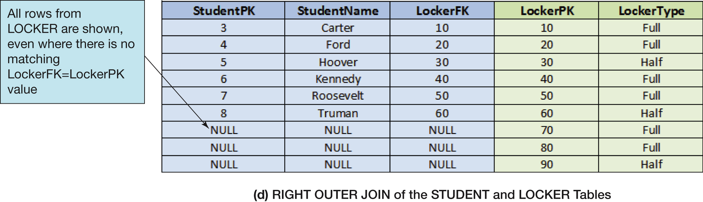
Figure 2-32 (4 of 4) RIGHT OUTER JOIN (STUDENT and LOCKER Tables)

Slide 41
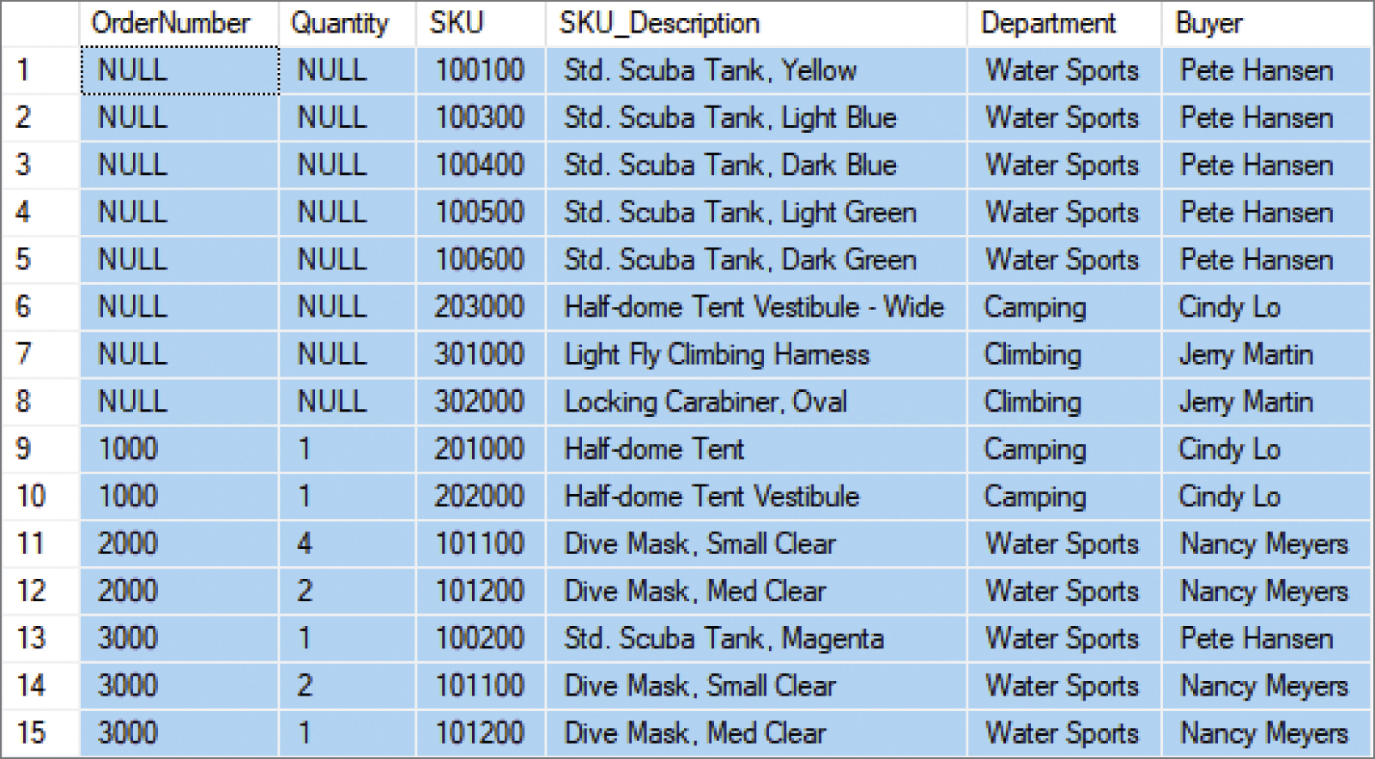
SQL RIGHT OUTER JOIN Example
/* *** SQL-Query-CH02-77 *** */
SELECT OI.OrderNumber, Quantity, SD.SKU, SKU_Description, Department, Buyer
FROM ORDER_ITEM AS OI RIGHT OUTER JOIN SKU_DATA AS SD ON OI.SKU = SD.SKU
ORDER BY OI.OrderNumber, SD.SKU;

Slide 42
Mathematical Set Theory
Mathematicians use the term set theory to describe mathematical operations on sets, where a set is defined as a group of distinct items.
A relational database table meets the definition of a set, so it is little wonder that SQL includes a group of set operators for use with SQL queries.

Slide 43
Venn Diagrams (1 of 2)
Venn diagrams are the standard method of visualizing sets and their relationships.
A set is represented by a labeled circle.
A subset is a portion of a set that is contained entirely within the set.
The union of two sets represents a set that contains all values in both sets. This is equivalent to an OR logical operation (A OR B).
The intersection of two sets represents the area common to both sets. This is equivalent to an AND logical operation (A AND B).
The complement of set B in set A represents everything in set A that is not in set B. This is equivalent to a logical operation using NOT (A NOT B).

Slide 44
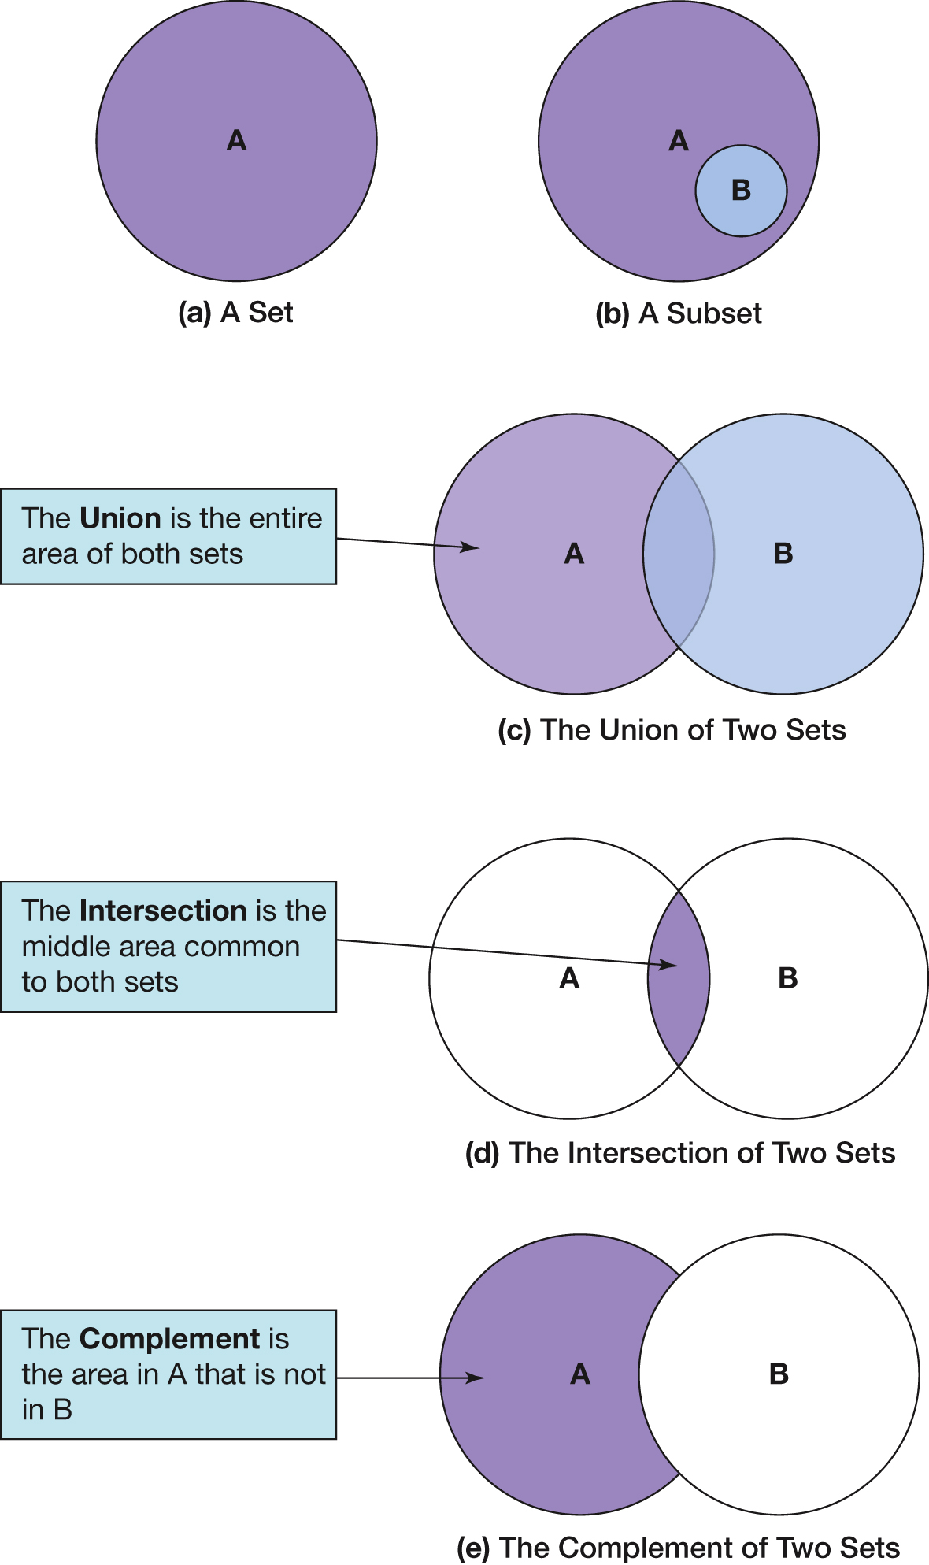
Venn Diagrams (2 of 2)

Slide 45
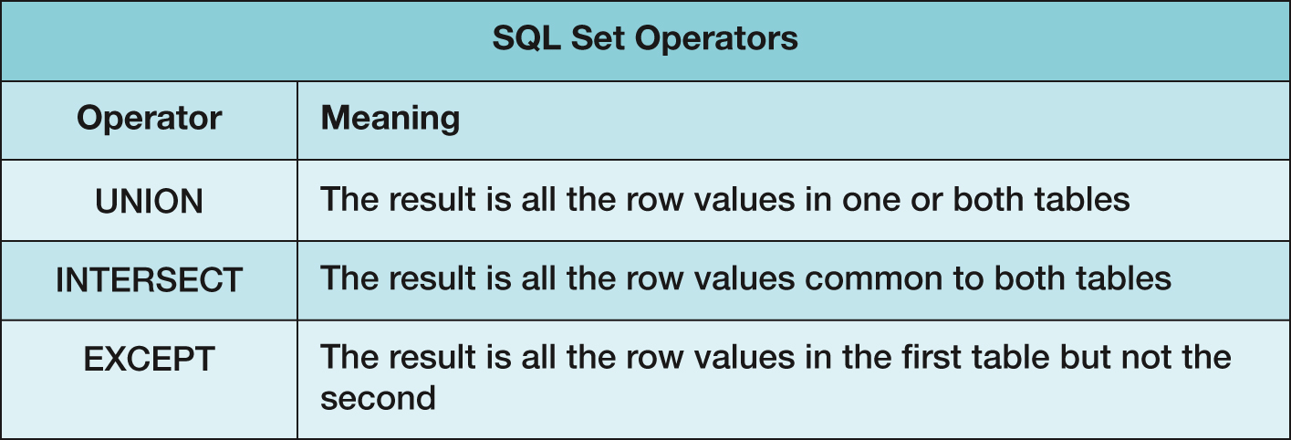
Figure 2-34 SQL Set Operators
Note that in order to use SQL set operators, the table columns involved in the operations must be the same number in each SELECT component, and corresponding columns must have the same or compatible (e.g., CHAR and VARCHAR) data types!

Slide 46
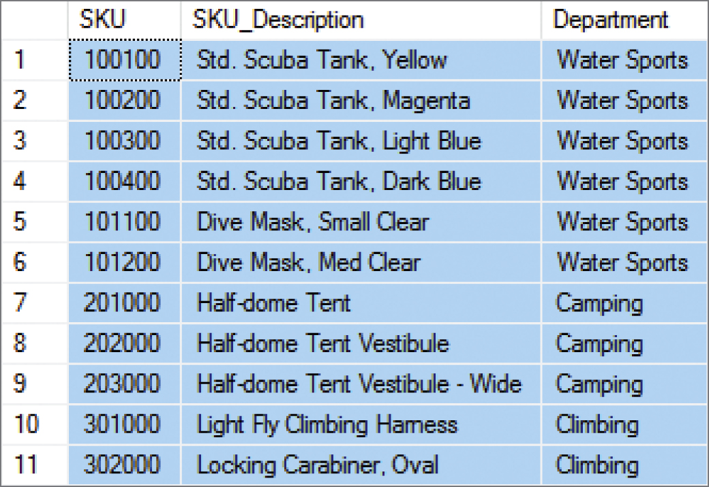
SQL UNION Operator
“What products were available for sale (by either catalog or Web site) in 2017 and 2018?”
/* *** SQL-Query-CH02-78 *** */
SELECT SKU, SKU_Description, Department
FROM CATALOG_SKU_2017
UNION
SELECT SKU, SKU_Description, Department
FROM CATALOG_SKU_2018;

Slide 47
SQL ALL Keyword
If we compare the output of SQL-Query-CH02-78 to the data in the CATALOG-SKU_2017 and CATALOG_SKU_2018, we will note that there are no duplicate rows in the query output. For example, SKU 201000, the Half-Dome Tent, is in each table, but only appears once in the query output. If, for some reason, we wanted the duplicated rows to be displayed in the query output as well, we would simply add the SQL ALL keyword to the query:
/* *** SQL-Query-CH02-78-ALL *** */
SELECT SKU, SKU_Description, Department
FROM CATALOG_SKU_2017
UNION ALL
SELECT SKU, SKU_Description, Department
FROM CATALOG_SKU_2018;

Slide 48
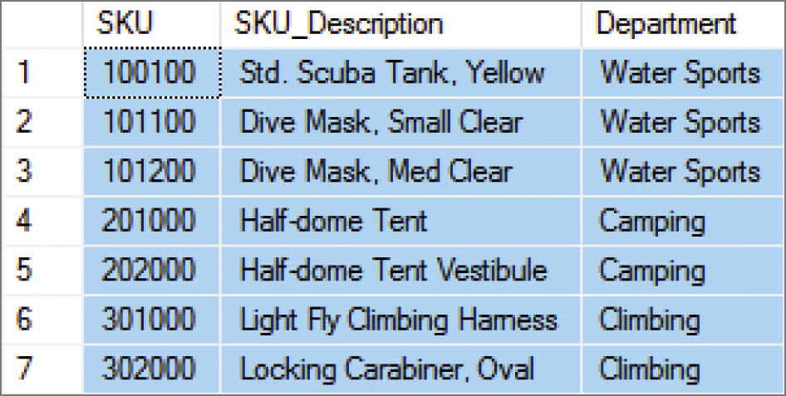
SQL INTERSECT Operator
“What products were available for sale (by either catalog or Web site) in both 2017 and 2018?” [MySQL 5.6 does not support the INTERSECT Operator]
/* *** SQL-Query-CH02-79 *** */
SELECT SKU, SKU_Description, Department
FROM CATALOG_SKU_2017
INTERSECT
SELECT SKU, SKU_Description, Department
FROM CATALOG_SKU_2018;

Slide 49
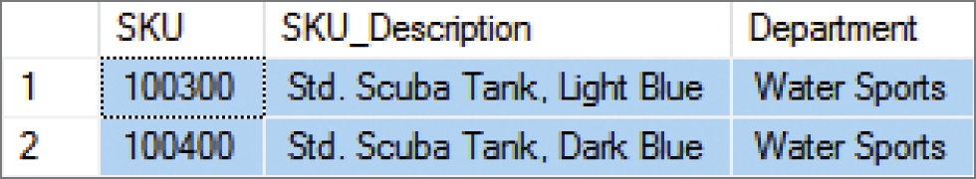
SQL EXCEPT Operator
“What products were available for sale (by either catalog or Web site) in 2017 but not in 2018?” [Oracle Database calls this the SQL MINUS operator, and MySQL 5.6 does not support this operation]
/* *** SQL-Query-CH02-80 *** */
SELECT SKU, SKU_Description, Department
FROM CATALOG_SKU_2017
EXCEPT
SELECT SKU, SKU_Description, Department
FROM CATALOG_SKU_2018;

Slide 50
Database Processing Fundamentals, Design, and Implementation (15th Edition)
End of Presentation:
Chapter Two
Part 2

Slide 51

Copyright

